Slide 1
Oracle ERP R12 Fundamentals
GE Renewables
7-Dec-2020

Slide 2
Agenda
Oracle EBS Introduction, Modules/Applications, and Architecture
Multiple Organization Structure (Multi-Org)
Flex fields
Multiple Organizations Access Control (MOAC)
Responsibilities, Menus, Functions and Profile Options
Oracle Login/Logout, Screens and Navigation
Oracle Workflow
Oracle Alert
Oracle Reports
Integrations
Races Architecture

Slide 3
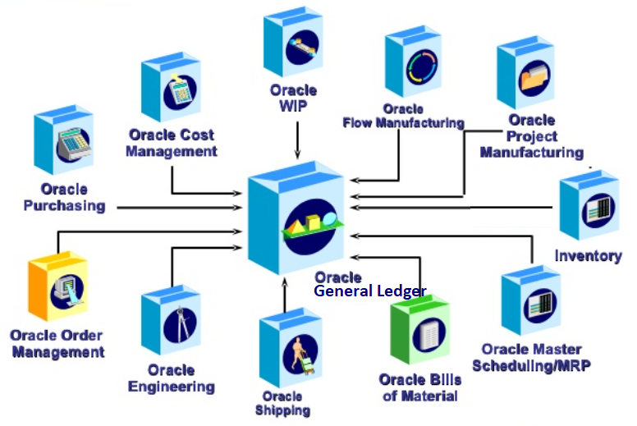
Architecture

Slide 4
HRMS
Employees, Locations, Organizations; Owner: Human Resources
Employees: Human Resources establishes employees to keep track of personnel information such as skills, benefits, jobs, and statuses. After the employees are defined in the system, they can be used for approval activities, processing expense transactions, and assigning of fixed assets.
Locations: Physical addresses, may represent company addresses, customer/supplier addresses.
Organizations:
An organization may be a physical site or it can represent a collection of sites sharing certain characteristics. These characteristics are used to define business structures within the Oracle
E-Business environment. Examples of organizations include, but are not restricted to:
• Legal entity: The business units where fiscal or tax reports are prepared
• Operating Unit: The level at which Enterprise Resource Planning (ERP) transaction data is secured
• Inventory organization: A business unit such as a plant, warehouse, division, and so on
• Expenditure/event organization: The unit that allows you to own events, incur expenditures, and hold budgets for projects

Slide 5
Getting Started - UI
Oracle EBS Login,
Personal Home Page, Navigator (Functions), Favourites, Work Lists (Notifications), and Preferences
Users, Responsibilities, Menus, Functions (AOL)
Oracle Application Framework (OAF) Applications
Forms based applications
Logout
Concept wise OA framework is completely different from Oracle Forms.
Oracle Forms: In Oracle forms we call screens as forms, developed with oracle forms builder tool. And we will save these files ad FMB files and Deployed as FMX.
OA Framework: OA Framework is used to Build HTML-based screens/pages in Oracle E-Business Suite. Pages are developed by using JDeveloper, saved as XML files and deployed by loading into the oracle apps database into a group of tables known as MDS.

Slide 6
Getting Started – Flex fields, Value set, Lookups
https://docs.oracle.com/cd/E14004_01/books/Fundamentals/fund_ref_kbshortcuts003.htm
A flexfield is a configurable field that opens in a window from a regular Oracle Applications Window. Defining flexfields enables you to tailor Oracle Applications to your own business environment. You can easily define flexfields to modify or extend Oracle Applications without programming. By using flexfields within Oracle Applications, you can:
• Structure certain identifiers required by Oracle Applications according to your own business environment
• Collect and display additional information for your business as required
https://docs.oracle.com/cd/E18727_01/doc.121/e12892/T354897T361279.htm

Slide 7
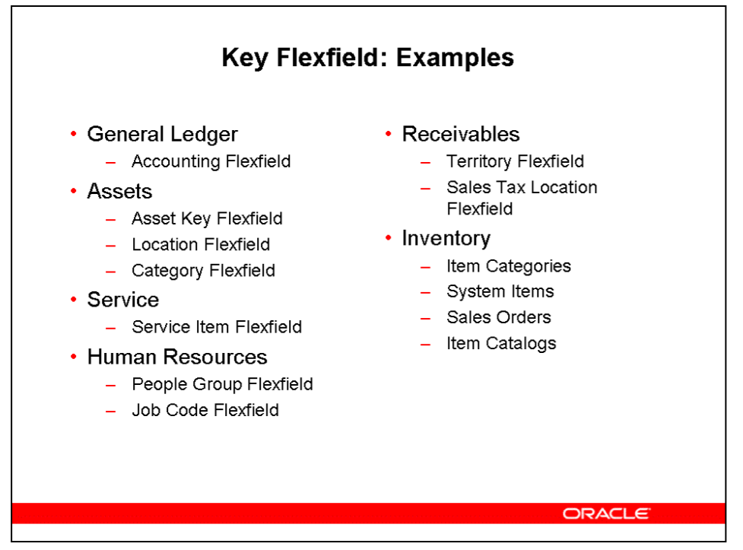
Getting Started – Flex fields, Value set, Lookups

Slide 8
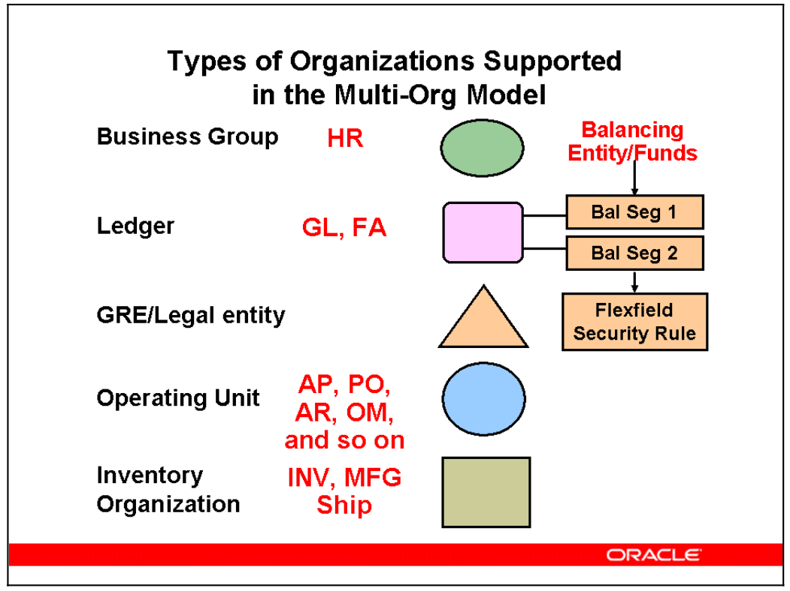
Multi ORG

Slide 9
Multi ORG
Define the Organization Structure Plan and define the entities in your organization structure. A careful analysis and design of a company’s organization structure is critical for future success.
The following points describe how the Multi-Org model relates organizations:
• A Business Group is the highest level of the structure and does not have an accounting impact. The Business Group determines which employees will be available to Ledgers and Operating Units related to that Business Group.
• A Ledger is the highest level that impacts accounting.
• Ledger is associated with a single Business Group. Multiple Ledgers may be associated with a single Business Group.
• Each Ledger may have a different chart of accounts structure, calendar, or functional currency.
• Each GRE/Legal entity is associated with a single Ledger, multiple Legal Entities may be associated with a single Ledger.
• Each Operating Unit is associated with a single GRE/Legal entity, multiple Operating Units may be associated with a single Legal entity.
• An Inventory Organization may be associated with any Operating Unit within the same Ledger.

Slide 10
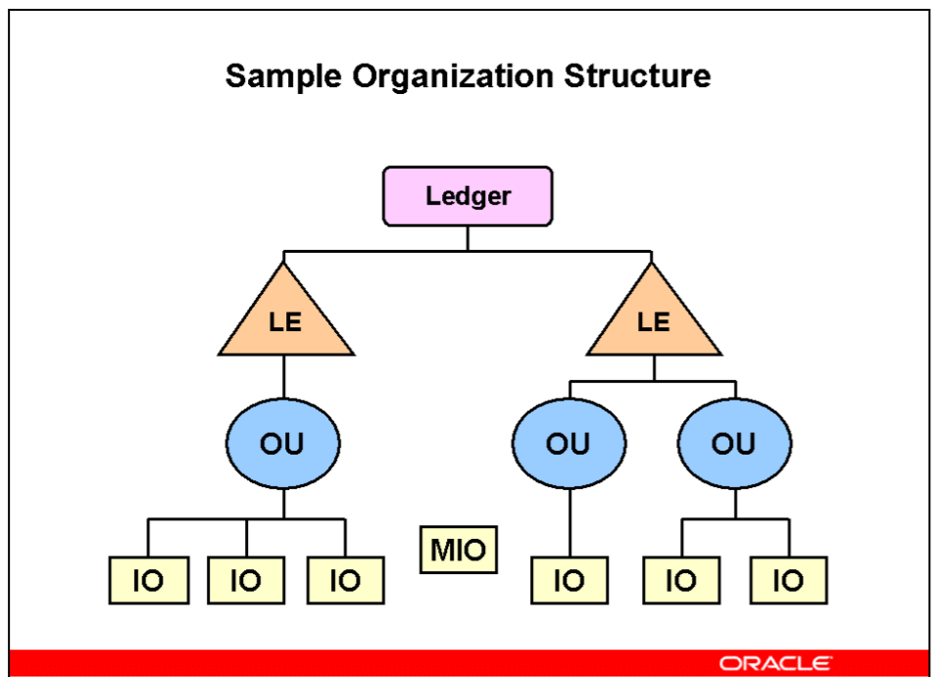
Multi ORG

Slide 11
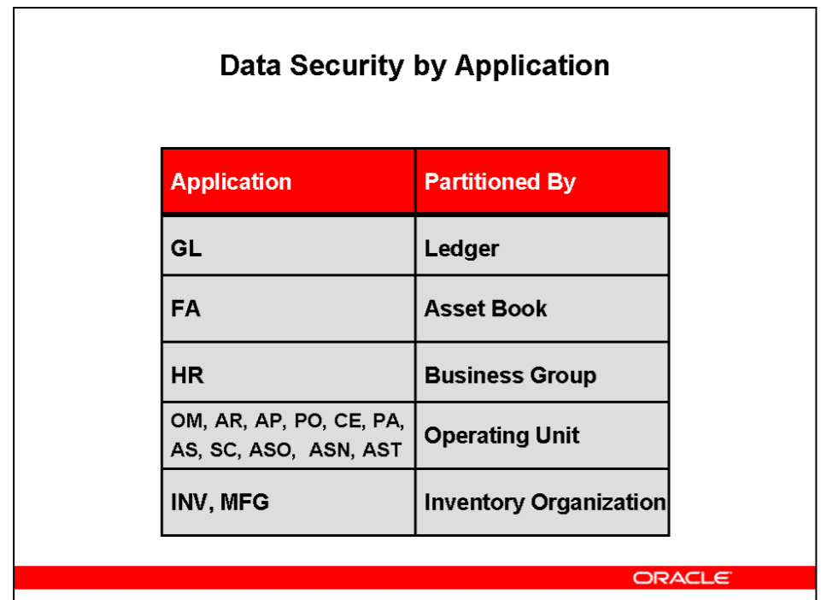
Multi ORG

Slide 12
MOAC
MOAC is basically the ability to access multiple operating units from a single application responsibility. Multi-Org preferences allows the user to control and limit the number of operating units they have access to based on their work environment. Cross organization reporting has been enhanced to be more in-line with the new MOAC. Users can run reports enabled for cross organization reporting, via their security profile, to summarize data for all operating units rolling up to a specific GRE/Legal entity or ledger.
Access One or More Operating Units Using Single Responsibility You can assign operating units to a security profile and then assign the security profile to responsibilities or users. If multiple operating units are assigned to the security profile, then a user can access data for multiple operating units from a single responsibility.

Slide 13
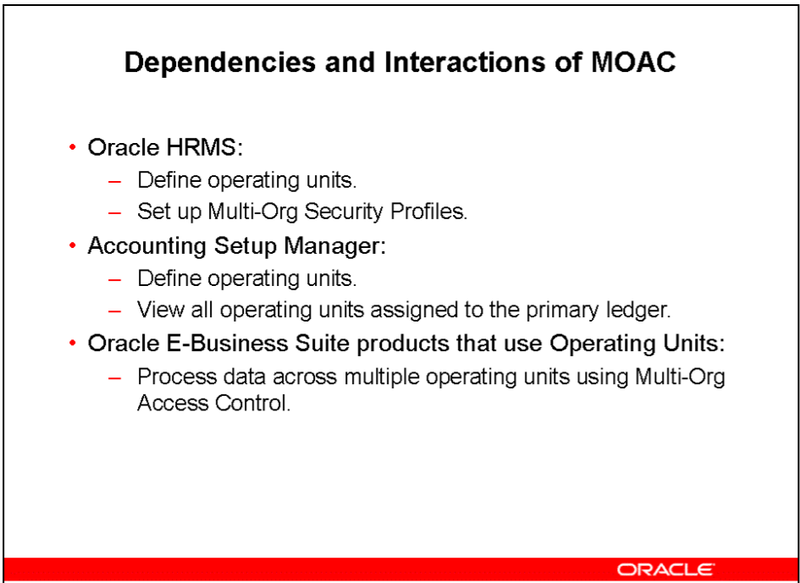
MOAC

Slide 14
General Ledger
Ledger; Owner: General Ledger
Ledger provides the means to collect and quantify financial data. Following are the three
primary elements to a Ledger:
• Chart of Accounts
• Calendar
• Currency
Accounting Conventions
Chart of Accounts
• Chart of accounts is the account structure that you define to fit the specific needs of your organization.
• You can choose the number of account segments as well as the length, name, and order of each segment.
Accounting Calendar
• Accounting calendar defines the accounting year and the periods that it contains.
• You can define multiple calendars and assign a different calendar to each set of books.

Slide 15
General Ledger
Currencies
• You select the functional currency for your set of books as well as other currencies used in
reports and business transactions.
• General Ledger converts monetary amounts entered in a foreign currency to functional
currency equivalents by using the supplied rates.
Ledger represents one of the main entities within Multiple Organizations Hierarchy. Ledger
information is used by all EBS applications. Some products use currency information, others
use calendar data, and still others use the chart of accounts information.

Slide 16
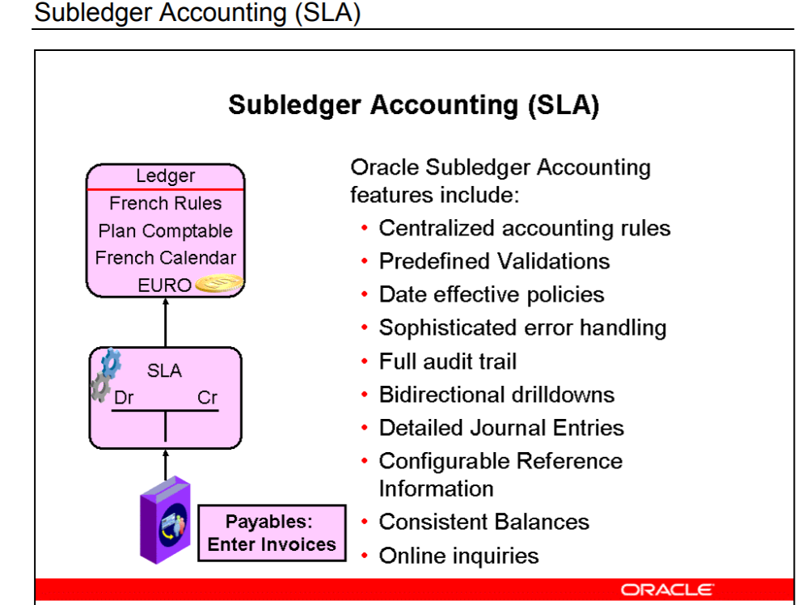
SLA

Slide 17
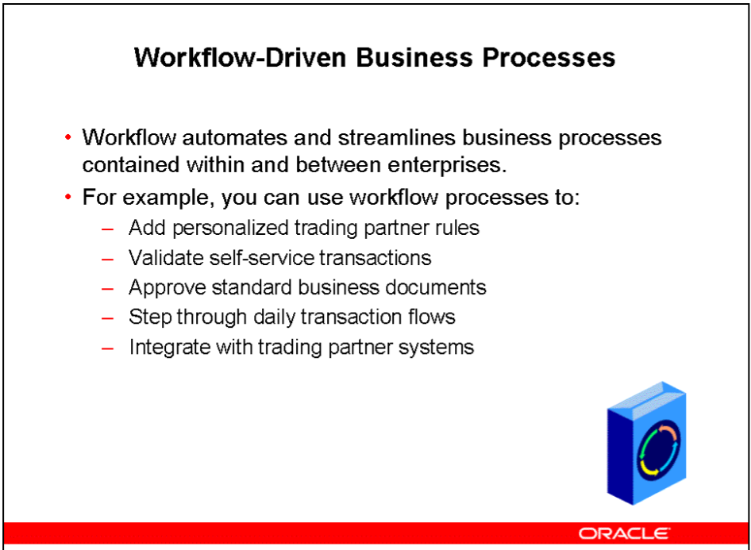
Workflow

Slide 18
Alert
Alerts monitor your database information and notify you when the condition that you have specified is found. You can define Alerts in any Oracle application or custom Oracle application. Some applications (Purchasing, for example) supply Alerts that can simply be activated and used. You can define one of two types of alerts: event and periodic.
• Event alert: Notifies you of activity in your database as soon as it occurs
• Periodic alert: Checks the database for information according to a schedule that you define

Slide 19
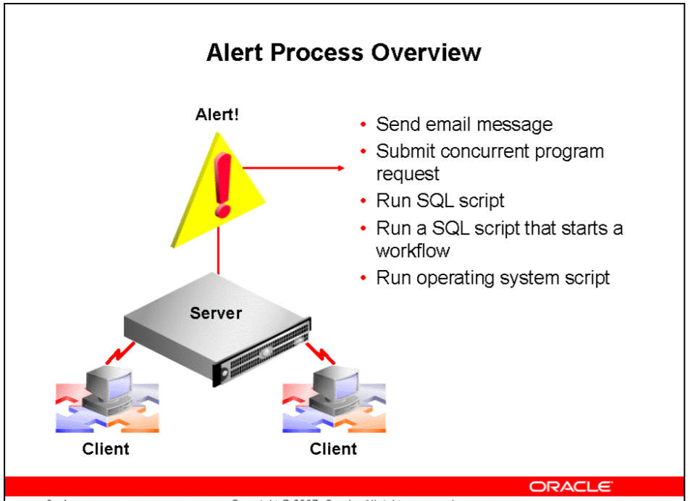
Alert

